Slide 1

XML & JSON in OLTP databases
Keep DB form

Slide 2
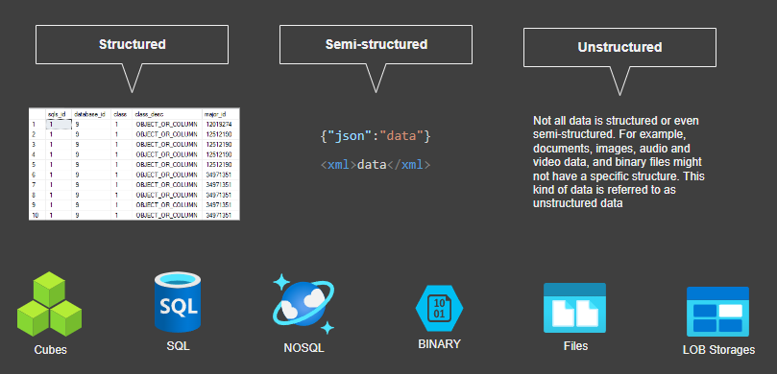
Data formats

Slide 3
1 NF
This is not normal!

Slide 4

Not indexed*

Slide 5

Not compressed*

Slide 6
Not compressed in backups
Data file
Full or Diff backup
Transaction LOG
TLOG backup

Slide 7
Potential headaches
Backup and restore
Maintenance
Performance
Disaster recovery
Out of SLA

Slide 8

Silver bullet
Do not store JSON, xml, or any LOB in OLTP DB

Slide 9
Kung fu time
Functions COMPRESS/DECOMPRESS
Indexes
Full text
XML
Computed columns *
Partition style
Filestream
TEXTIMAGE_ON
Partition functions
Compression
Filesystem compression (OS) *
Columnstore indexes

Slide 10
Indexed computed column
ALTER TABLE Sales.SalesOrderHeader ADD vCustomerName AS JSON_VALUE(Info,'$.Customer.Name’) CREATE INDEX idx_soh_json_CustomerName ON Sales.SalesOrderHeader(vCustomerName)

Slide 11

Clustered and partioned
CREATE TABLE j ( i INT IDENTITY(1, 1) NOT NULL, jsn NVARCHAR(MAX) NOT NULL, computed AS (CONVERT(VARCHAR(900),JSON_VALUE(jsn, '$.id'))) PERSISTED ); CREATE CLUSTERED INDEX ci ON j (computed) WITH (DATA_COMPRESSION = PAGE) ON part_sch(computed); GO INSERT j SELECT('{"id":"1"}’); SELECT * FROM dbo.j

